Slide 1
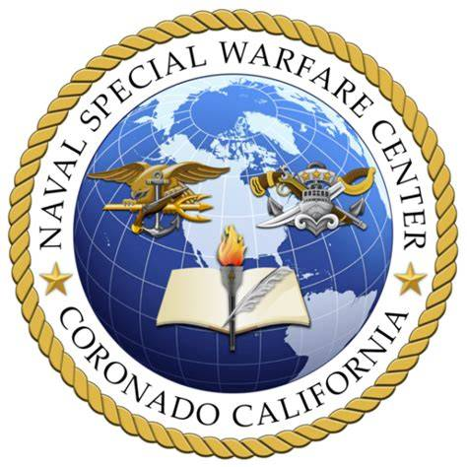
NSWC
(MOB-C / Mobility Training Course)
VM Class 001
CO: LTCDR J. Rola
031300MAR2025 (LOCAL)
The overall classification for this document is: UNCLASSIFIED - FOR OFFICIAL USE ONLY

Slide 2
Purpose & Scope
Vehicle mobility refers to the employment of ground vehicles to support and execute a wide range of operational tasks. This includes, but is not limited to, infiltration and exfiltration of personnel, positioning for follow on actions. Vehicle mobility enables rapid, controlled, and coordinated movement across the battlespace while maintaining security, situational awareness, and operational tempo.

Slide 3
Purpose & Scope
Keep in mind that vehicle mobility is highly dynamic one of the most rapidly changing environments we operate in, second only to dynamic CQB. Terrain, threat, and situational factors can shift quickly, and vehicle speeds must adapt accordingly. This document provides the standardized baseline for mobility operations. Regardless of debates or individual preferences, these standards serve as the default framework for planning, executing, and evaluating convoy movement.

Slide 4
Overview & MISC
The ideal movement speed is 45 kph.
The default will always be to move threw the event line ie blowing past a ambush

Slide 5
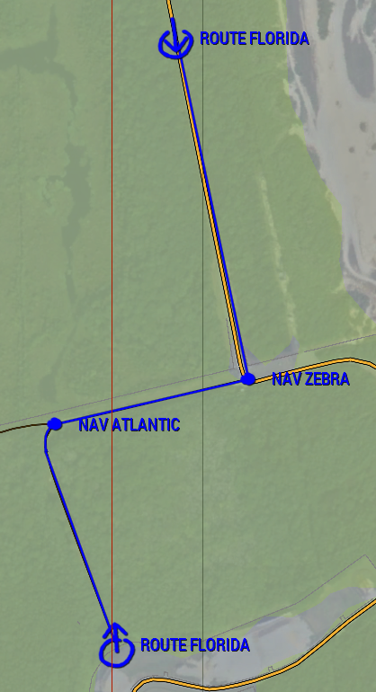
Route Marking & Planning
Route Marking & Planning
Start & End Points – Clearly marked to designate the beginning and end of the route.
Route Marking – Routes will be shown as a colored line on the map. – Each route is assigned a codename (e.g., ATLANTIC, FLORIDA, etc.). – Codenames allow quick, clear reference over radio.
Navigation Points (NAV Points) – Named using codewords. – Placed at key terrain, distance markers, intersections, choke points, or decision points. – Used to maintain situational awareness and track convoy progress.

Slide 6
Radio Brevity
Convoy Start Movement
Convoy Commander / GFC “Vehicle check-in on XXX freq.”
Individual Vehicles “Vic 1 up with 2.” “Vic 2 up with 3.” “Vic 3 up with 4.” (Format: “Vic # up with total personnel”)
Convoy Commander / GFC “Vic 1, cleared to move/roll.”

Slide 7
Roles & Responsibilities
Convoy Commander / Ground Force Commander if Applicable
The Convoy Commander is responsible for selecting and briefing the route, delivering the movement plan in a METT-TC format, and making all major movement decisions such as directing a herringbone or other security posture unless incapacitated or directly involved in the incident. In emergency situations, other personnel may take initiative as required.
The Convoy Commander must also ensure all contingency plans are established and understood, including actions for downed vehicles, redistribution of personnel, passenger count per vehicle, and individual task assignments.

Slide 8
Roles & Responsibilities
Dismount Types
Driver / Navigator
Soft Dismounts – Non-essential passengers – Driver / Gunner typically remain with the vehicle
Hard Dismounts – All passengers dismount
Driver – Responsible for driving and vehicle control.
Navigator – Handles radio communications. – Relays route updates, hazards, and information to the driver.
Driving Restrictions – Medics / CLS should not drive unless necessary. – Any personnel restricted by Team Leaders or senior personnel. – Key medical personnel (e.g., M1) should not be placed in the lead vehicle.
CSW
HARD
SOFT

Slide 9
Herringbone technique (Theory)
The herringbone is a security technique used when operating in closed or confined terrain where vehicles cannot pull fully off the main route such as urban areas, dense forests, narrow mountain roads, or restricted MSRs. In this formation, vehicles angle alternately left and right, creating staggered fields of fire and maximizing 360° security.

Slide 10
Y technique (Theory)
The Y technique is used when terrain allows vehicles to move well off the road usually up to 100m to gain a wider view of the area. By spreading out into a “Y”shaped pattern, vehicles avoid clustering near the route and reduce the chance of multiple elements being hit within the same lane of fire. This wider dispersion offers better situational awareness and generally provides a safer posture than the herringbone in open or semi open terrain.

Slide 11
Blow-through (Theory)
Event Line (Theory)
A blow-through is used to rapidly move past an event line or obstacle such as a downed vehicle, hasty checkpoint, small enemy element, or anything deemed necessary without stopping. The goal is to maintain momentum, avoid getting fixed in place, and push the convoy beyond the threat area as quickly as possible.
The event line is the identifiable point on the route where the convoy must make a decision: either stay to the rear or blow through. It marks the start of the hazard area such as a checkpoint, downed vehicle, blockage, or enemy presence and serves as the trigger for actions on contact. Once a vehicle crosses the event line, the element commits to either stopping to address the situation or maintaining speed and pushing past it.

Slide 12
Herringbone
INFRONT REAR
EVENT LINE

Slide 13
The “Y”
INFRONT REAR
EVENT LINE

Slide 14
Blow-through Herringbone
INFRONT REAR
EVENT LINE

Slide 15
Blow-through “Y”
INFRONT REAR
EVENT LINE

